Slide 1
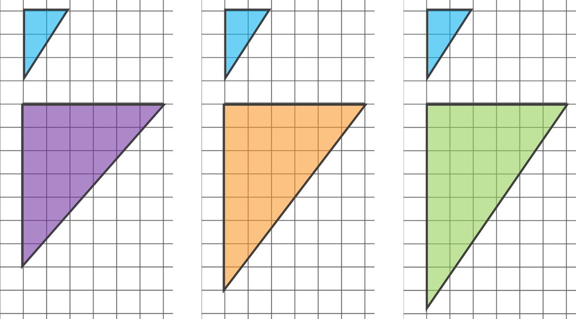

Describing an enlargement
Task A: Using and finding scale factors
1. Parallelogram P has been enlarged to create A, B, C and D. Calculate the missing lengths on each parallelogram.
8 cm
9 cm
P
6 cm
B
3 cm
C
2 cm
4 cm
3 cm
20 cm
18 cm
A
D
16 cm
15 cm
2. Tick the diagram that shows a correct enlargement of the small triangle.
Sam draws another enlargement of the small triangle. One of the lengths is 12 cm. What could the other length be?
8 cm or 18 cm
Or if the diagonal length is measured as 12 cm then the other two lengths would measure as approximately 6.7 cm and 10 cm.

Slide 2
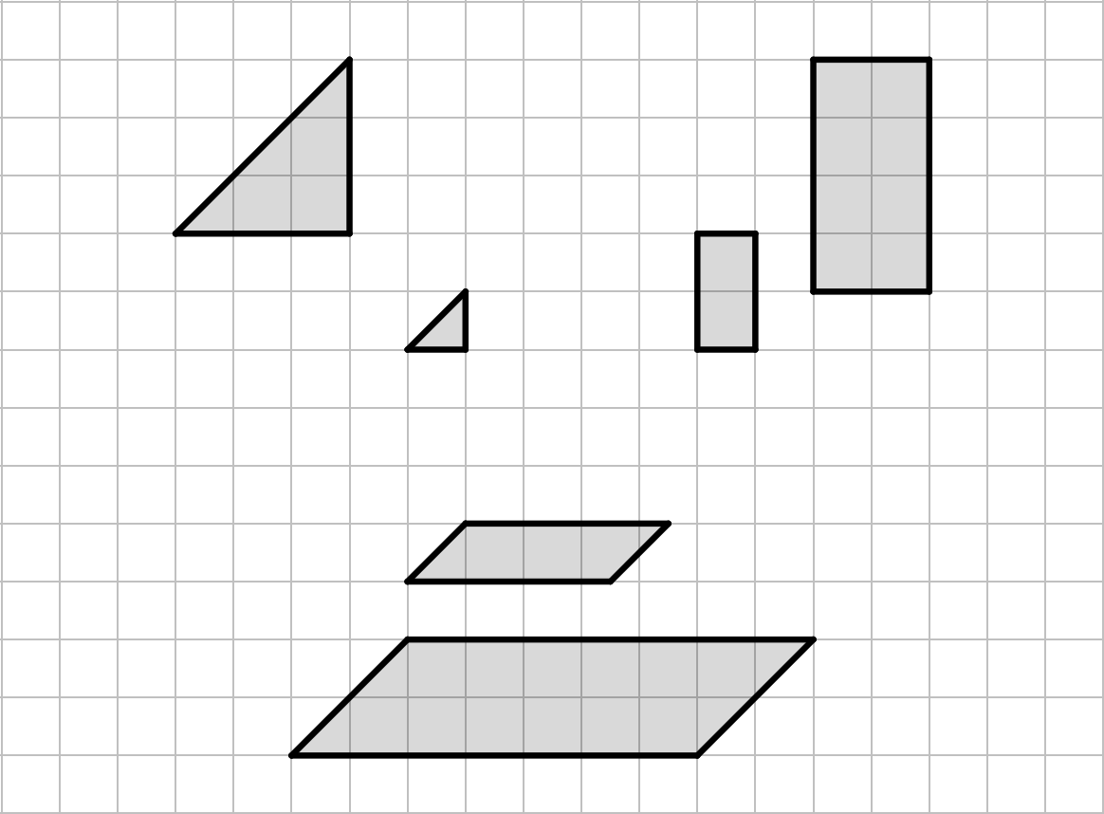
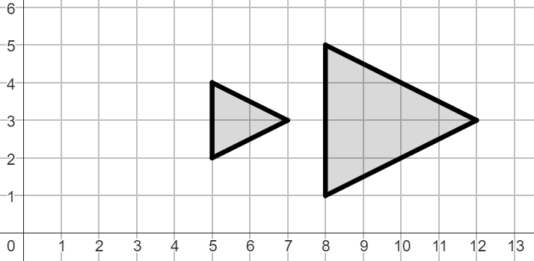
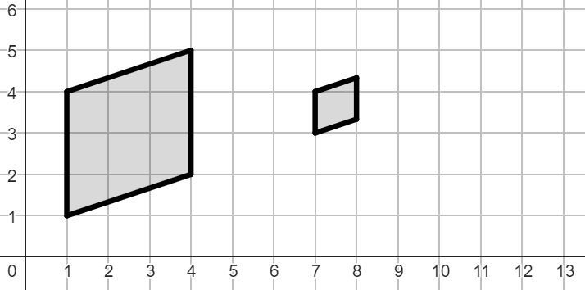

Describing an enlargement
Task B: How the centre of enlargement affects the image
1. Tick the enlargements that have the same centre of enlargement.
A to A′
B to B′
C to C′
A′
B′
A
B
C′
C
2. Describe each transformation fully.
a) A to A′
b) B to B′
A
B′
A′
B
Object A has been enlarged
by a scale factor of 2,
from the point (2,3)
Object B has been enlarged
by a scale factor of ,
from the point (10,4)
Mathematics in Education and Industry
v2.2

